Slide 1
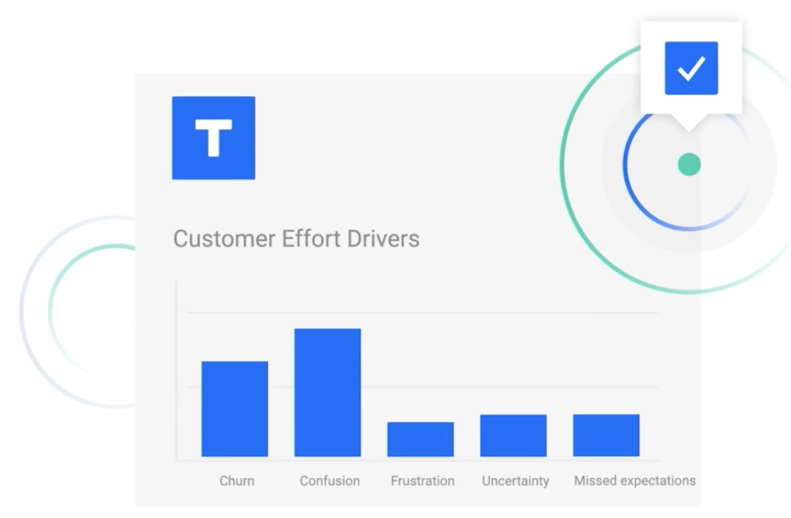
Focal point playbook
Increase agent advocacy on difficult interactions
©2022 Tethr. All Rights Reserved.

Slide 2
EXAMPLE
What Tethr will help us do
Reduce customer effort
Increase customer satisfaction
Improve customer experience
Upgrade coaching programs
In our first sprint, we will start Increasing Agent Advocacy on Difficult Interactions.
End goal: Move from 50% Advocacy rate to 55% in 4 weeks.

Slide 3
EXAMPLE
Launching Tethr with Our Team
Sprint Approach: Select one team to kick off our first Tethr sprint. Focus on [Focal Point] with the team to coach behaviors, measure results and collect feedback from team leaders and team members
We are here
1/1
1/7
1/10
1/21
1/25
2 week sprint ends
Sprint results
Build custom dashboards
Introduce Tethr to first sprint team
Launch full Tethr program with team
Sprint results measured and feedback solicited from team. Coaching continues
Review results, key learnings, and adjust approach before launching to global team – Target 2/15
Build initial test dashboards leveraging existing Tethr categories for key behaviors
Share overview, dashboards and playbooks with team leaders
Introduce concept, measurement details, and expectations to team

Slide 4
EXAMPLE
Detailed focal point outline
Goal
Focal point name
Metric
Execution + communication
Improve customer experience
Reduce customer effort
Increase Advocacy on Difficult Interactions
Tethr will measure the percentage of interactions with a TEI score of <4 that also had Advocacy language from the agent
Site leadership & supervisors will coach agents [weekly/bi-weekly] using the Tethr Dashboard provided to them. Supervisors will monitor and coach agents use of advocacy on difficult interactions
Goal: to increase use of advocacy from XX% to XX%
Results communicated to: [Leadership and Business Sponsor]

Slide 5
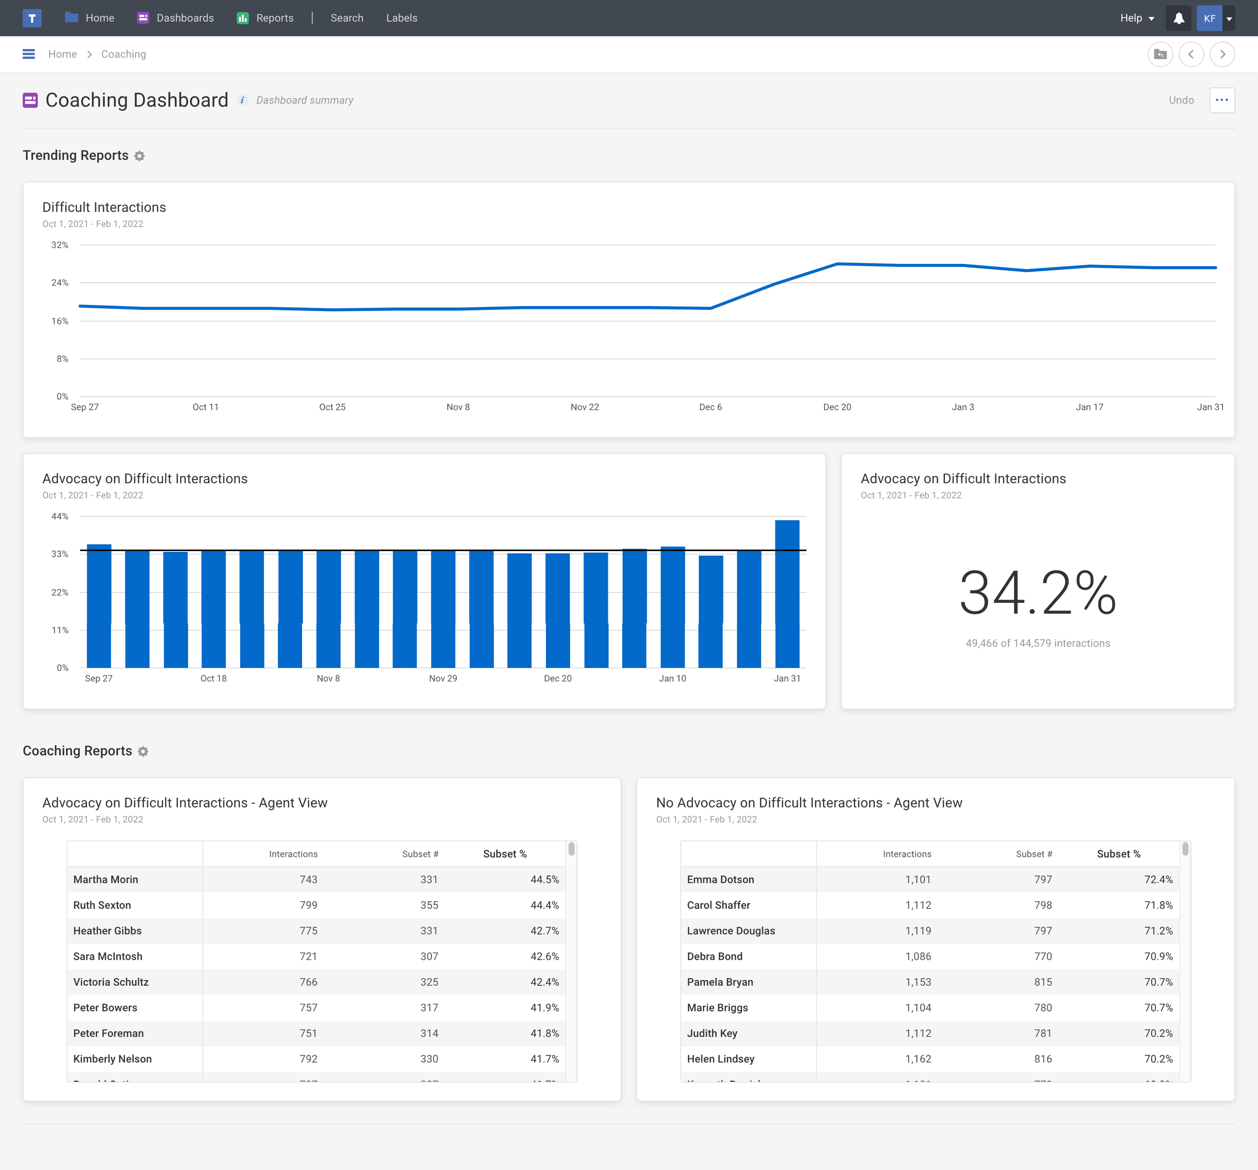
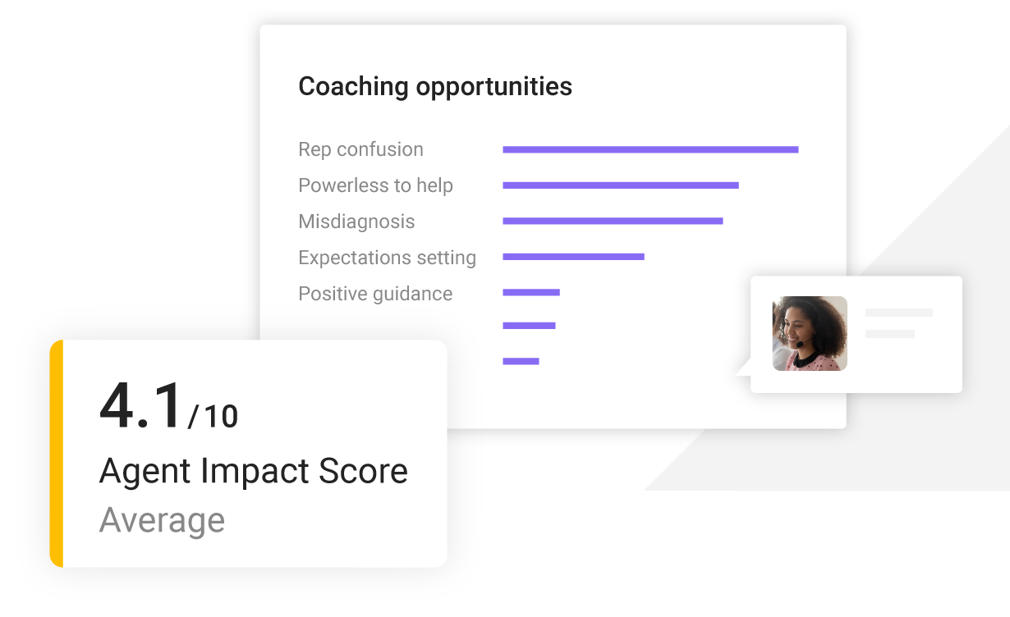
Tethr coaching dashboard
You will receive a Coaching Dashboard like this one that you can access by logging in to Tethr. Use these reports to find coaching opportunities and track your team’s performance.

Slide 6
Increase Agent Advocacy on Difficult Interactions
What agents are responsible for to improve the customer experience:
When you hear phrases like these…
Say something like this:
Frustration:
“I’m really upset about this”
“this is a huge waste of my time”
“very disappointed in the delivery service”
“you are not listening to me”
“this is outrageous”
Confusion:
”I’m just confused”
“I really don’t know where to start”
“this doesn’t make any sense”
“what are you talking about”
Advocacy:
“I can take care of that for you”
“let me look at your account right now”
“I will check what I can do”
“we can resolve this”
”I can assure you that…”
“I can provide more information to you”
“another option I can offer you is…”
“I can help you with that”
“I’ll make sure this gets resolved”
“I will do that”
“what I can do is”
Missed Expectations:
”I thought you were going to call me back”
“I was told…”
“that’s not what I was told”
“I never heard anything”
Chronic Effort:
“I’ve been trying to get an answer for several days now”
“this problem has been happening for six months and no one has been able to fix it”

Slide 7
Appendix
Tethr overview slides and playbook table of contents

Slide 8
TEMPLATE
Our Results
Avg. call duration decreased by XX:XX
Difficult Interactions decreased by XX%
Explicit Satisfaction increased by XX%
In [Timeframe] our teams increased Advocacy X% moving from XX% to XX%

Slide 9
Key elements of a Tethr Playbook
Focal Point Introduction
What is the focus of your work in Tethr? What will these focal points do for your organization?
Execution Plan & Timeline
Include specific high-level milestones that both leadership & coaching teams can expect. Set a deadline for reporting results of first sprint.
Detailed Focal Point Outline
Full outline of each focal point with detailed metrics & execution plan.
Focal Point Dashboard
Screenshot of Tethr Dashboard supporting focal point with notes if needed.
Coaching ”Cheat Sheet”
Handout for coaches and agents to know exactly what to say/not say to move the needle
Results
Communicating results and the impact those results have had on high-level KPIs like handle time, customer experience, etc.

Slide 10
Powerful integrations for transformative insights
The platforms that you know and trust
Secure, simple integration
Share insights with your favorite tools

Slide 11
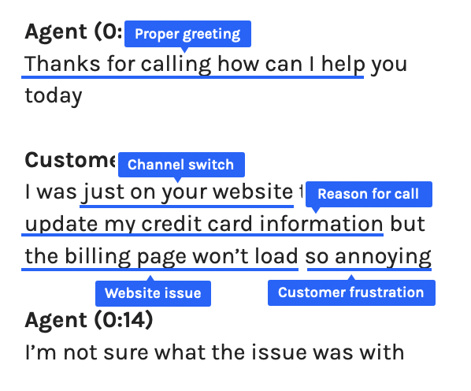
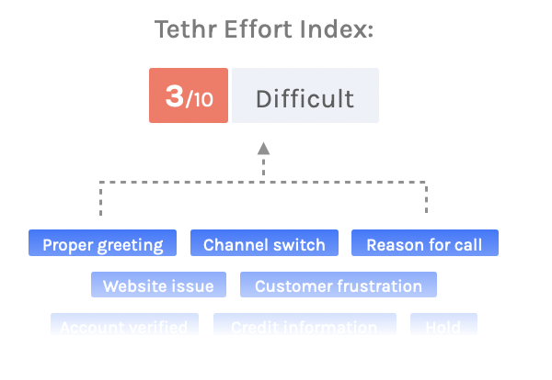
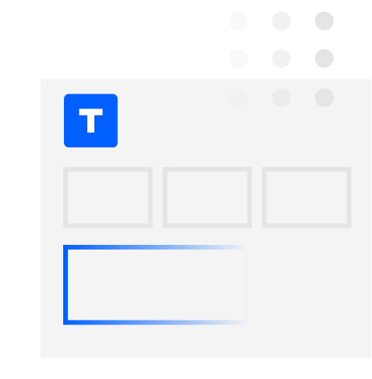
How AI-based conversation intelligence works
2. Structure recording transcript with machine learning tools
3. Tethr scores every interaction utilizing AI technology
4. View clear outcomes in your dashboards & digests
1. Record customer conversation
“I was just on your website trying to update my credit card information, but the billing page won’t load. So annoying!”

Slide 12
Built for the everyday user.
Instantly search millions of customer conversations
Quickly build and share new dashboards and reports
Easily teach the machine to find new insights

